Slide 1
NEXT WORD PREDICTION
PROJECT BY:
GROUP 17
MAAZ ANSARI (J002)
HARSH GUPTA (J017)

Slide 2
TABLE OF CONTENTS
Problem Formulation
EDA
01
07
Logistics
Data Preparation
02
08
Data
Model Generation
03
09
Approach
Predictions
04
10
About RNN & LSTM
Deployment
05
11
Solution Flow
Conclusion
06
12

Slide 3
PROBLEM FORMULATION
We are opening a blog for data scientists, where people can write articles and submit their ideas and solutions. To create a self made search algorithm, we are using our own algorithm to train the models on pre existing medium (https://medium.com/) articles and help us for predicting the next word according to the input in the search bar.
As we do more and more typing into non-traditional keyboards every advantage in ease of typing becomes more critical. Next word prediction is a means of helping the user to type faster by suggesting common words that are likely to follow, thus saving time of the user.

Slide 4
LOGISTICS
Libraries used:
NLTK, Pandas, NumPy, Re, TensorFlow, Keras, Flask, Pickle, Matplotlib
Languages:
HTML, CSS, Python, javaScript
`
Applications Used:
Google Colab, Jupyter, Spyder, Ananconda
`

Slide 5
DATA
Medium is one of the most famous tools for spreading knowledge about almost any field. It is widely used to published articles on ML, AI, NLP and data science. This dataset is the collection of about 350 articles in such fields.
The dataset contains articles, their title, number of claps it has received, their links and their reading time in which we will focus on the articles. You can have a look at the dataset by clicking here.

Slide 6
APPROACH
We have used the concept of RNN to create a model with LSTM layers to read a sequence of words converted into numbers. Using the model we have tried to capture the words which come after a particular sequence and generate the output accordingly

Slide 7
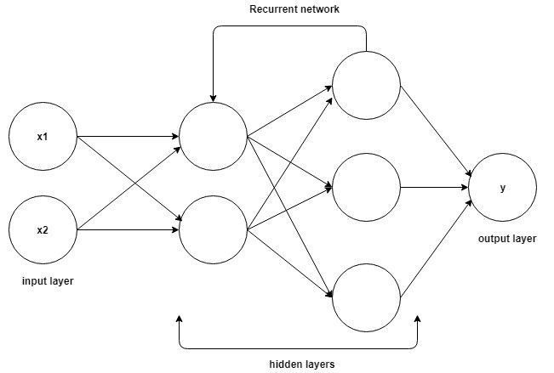
WHAT IS RNN?
Unlike Feed-forward neural networks in which activation outputs are propagated only in one direction, the activation outputs from neurons propagate in both directions (from inputs to outputs and from outputs to inputs) in Recurrent Neural Networks. This creates loops in the neural network architecture which acts as a ‘memory state’ of the neurons. This state allows the neurons an ability to remember what have been learned so far.

Slide 8
HOW IS LSTM BETTER THAN RNN?
The memory state in RNNs gives an advantage over traditional neural networks but a problem called Vanishing Gradient is associated with them. In this problem, while learning with a large number of layers, it becomes really hard for the network to learn and tune the parameters of the earlier layers. To address this problem, A new type of RNNs called LSTMs (Long Short Term Memory) Models have been developed.
LSTM model is a special kind of RNN that learns long-term dependencies. It introduces new structure — the memory cell that is composed of four elements: input, forget and output gates and a neuron that connects to itself.

Slide 9
SOLUTION FLOW
Tokenize data and convert into sequences
Create LSTM model
Make Predictions
Input Raw Data
1
2
3
4
5
6
7
8
Clean Data
Pad sequences and create predictors and label
Fit the model on the training data
Deploy the model

Slide 10
EXPLORATORY DATA ANALYSIS
Natural Language Processing task needs more time on cleaning and exploring the text data. Exploratory data analysis (EDA) is an approach to analyzing data sets to summarize their main characteristics, often with visual methods.
For EDA we use .iplot which is an interactive plot and it helps us to interpret the plots in a better way and also save plots easily.

Slide 11
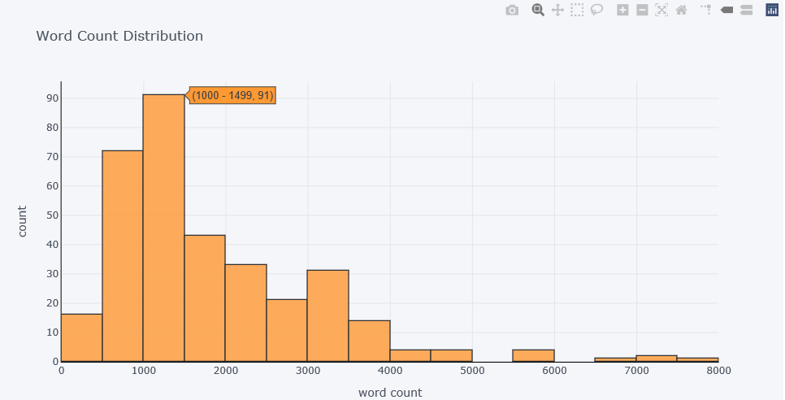
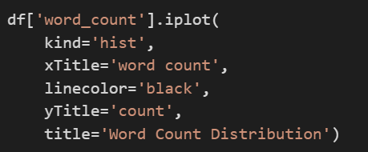
Word Count Distribution

Slide 12
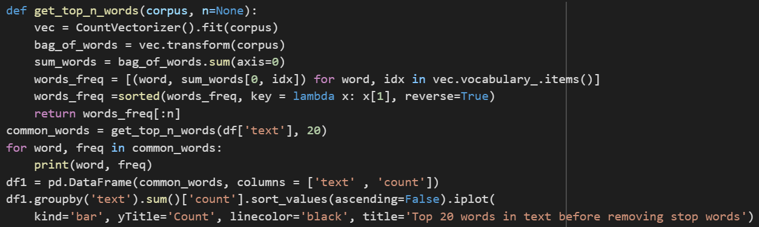
The distribution of top words before removing stop words

Slide 13
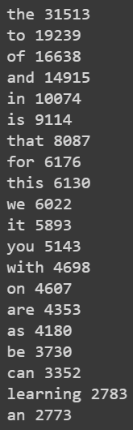
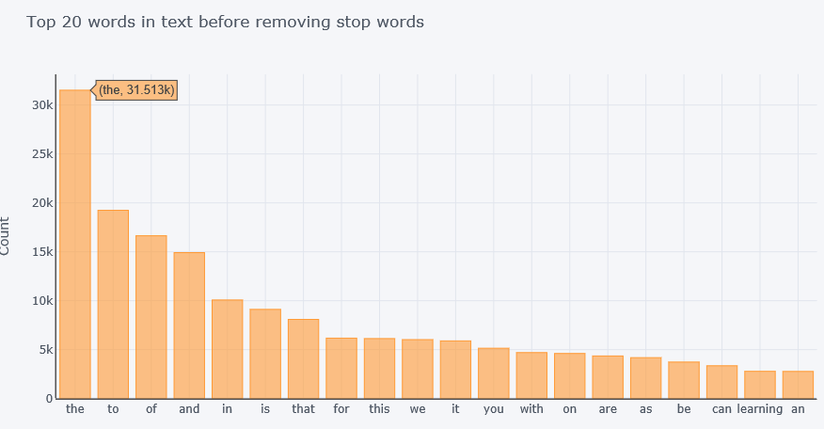
The distribution of top words before removing stop words

Slide 14
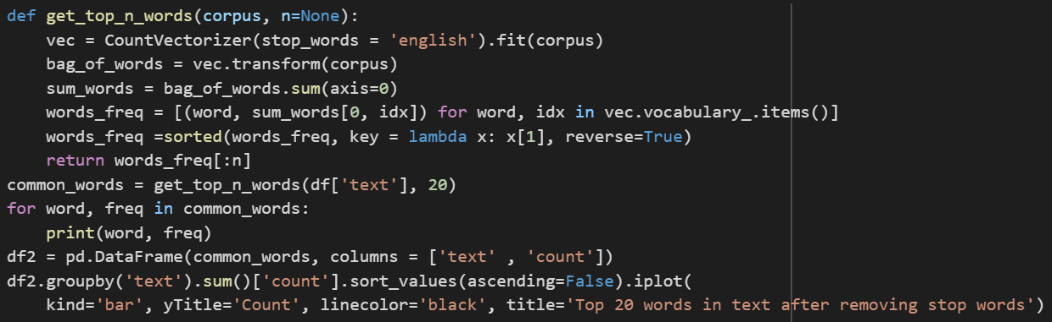
The distribution of top words after removing stop words

Slide 15
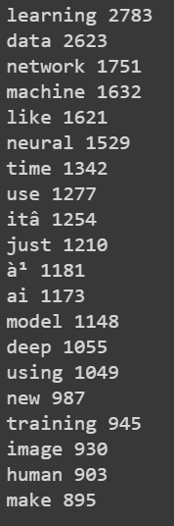
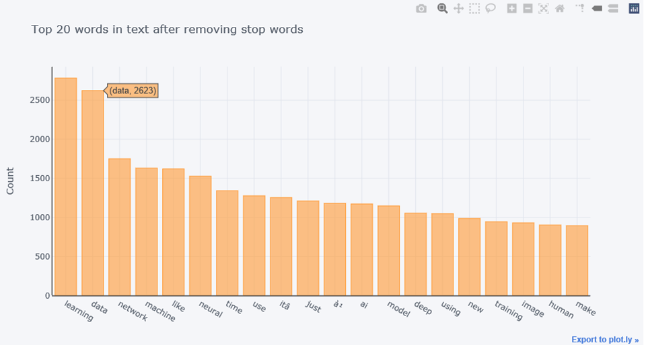
The distribution of top words after removing stop words

Slide 16
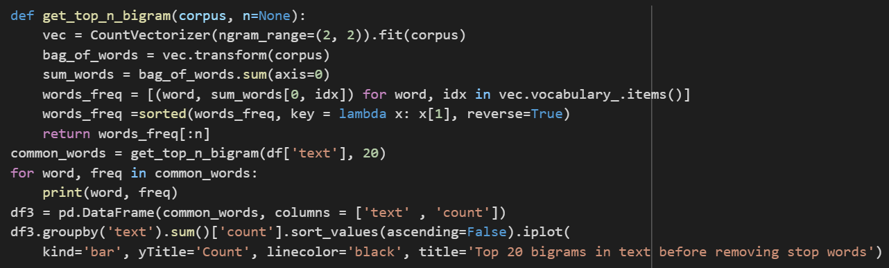
The distribution of top bigrams before removing stop words

Slide 17
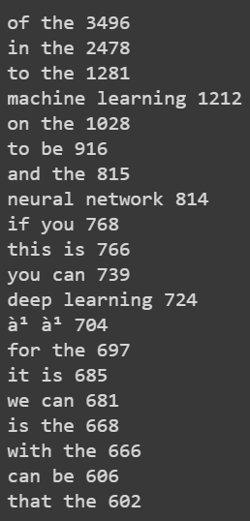
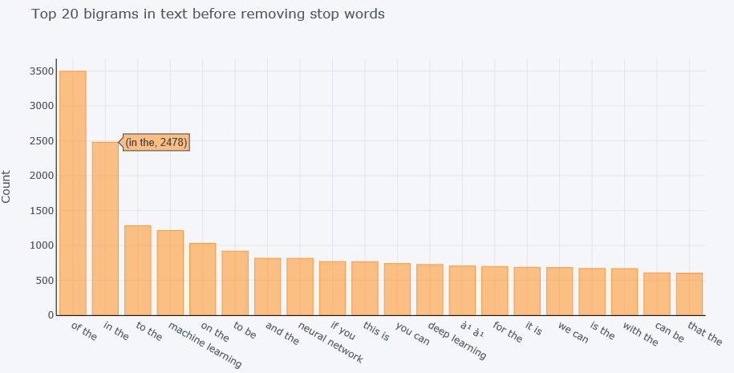
The distribution of top bigrams before removing stop words

Slide 18
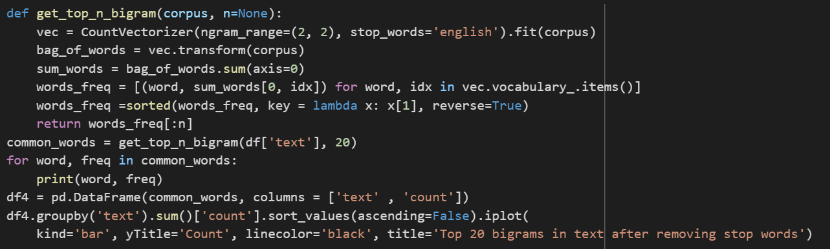
The distribution of top bigrams after removing stop words

Slide 19
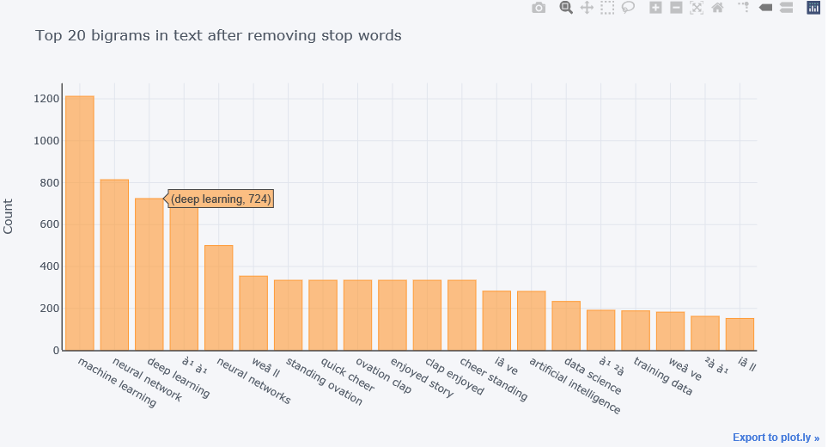
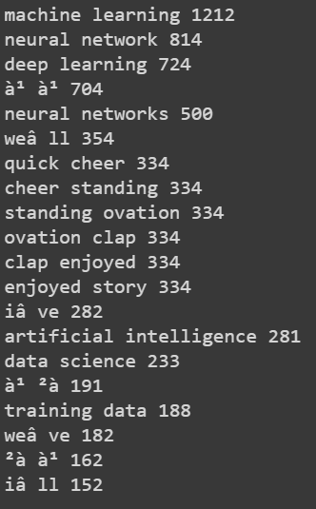
The distribution of top bigrams after removing stop words

Slide 20
DATA PREPARATION
To prepare the data, we have first removed punctuations, symbols and stopwords. The data has then been tokenized and converted into sequences. These sequences are then padded and the labels are created by taking the last word of every sequence.

Slide 21
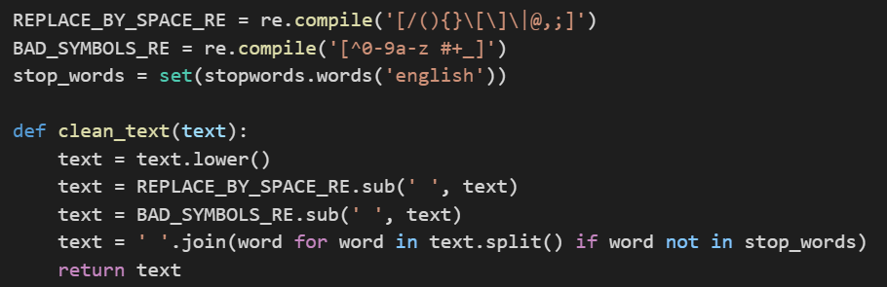
Remove Punctuations, Symbols and Stop Words
You cannot go straight from raw text to fitting a machine learning or deep learning model. First we must clean your text first, which means splitting it into words and handling punctuation and case.
Here are a few key benefits of removing stopwords:
On removing stopwords, dataset size decreases and the time to train the model also decreases
Removing stopwords can potentially help improve the performance as there are fewer and only meaningful tokens left. Thus, it could increase classification accuracy
Even search engines like Google remove stopwords for fast and relevant retrieval of data from the database

Slide 22
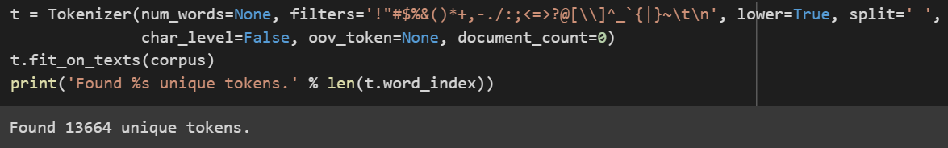
Tokenization
We turn the texts into space-separated sequences of words in lowercase. These sequences are then split into lists of tokens. Hence we convert the corpus into sequence of tokens using tokenization.

Slide 23
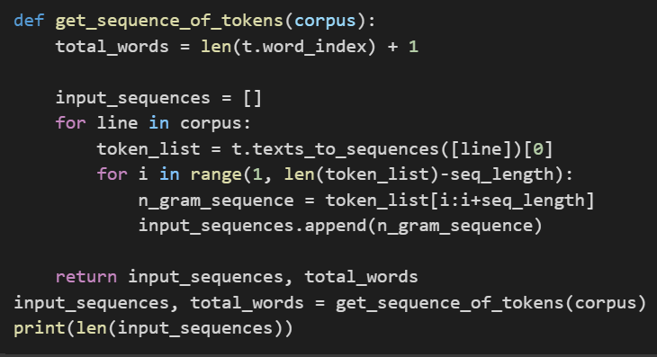
Convert the articles into sequences
Now after Tokenization, we convert the corpus into sequence of tokens. We have defined the sequence length as 20. The output can be seen in the next slide.

Slide 24
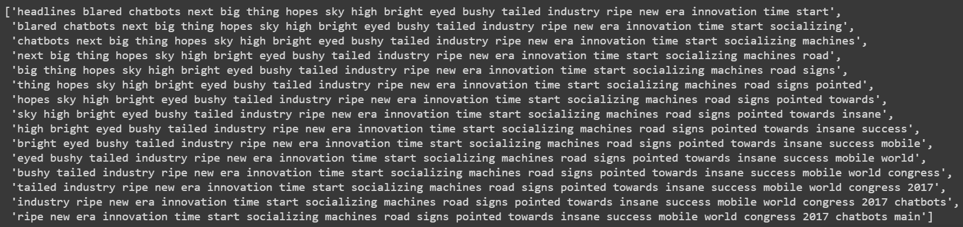
Output of the sequence of tokens
Here we can see the sequences generated, with a length of 20 words per sequence

Slide 25
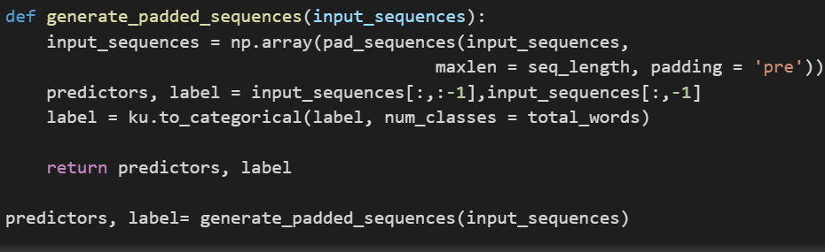
Pad sequences and create predictors and label
The sequences are taken and padded to a uniform length of 20. The last word of every sequence is then taken as the label for the sequence.

Slide 26
MODEL GENERATION
To build the the model, we have used Keras Sequential method and added embedding, LSTM and Dense layers. The final model is being evaluated on the basis of training loss and is being stored in a hdf5 file for deployment use.

Slide 27
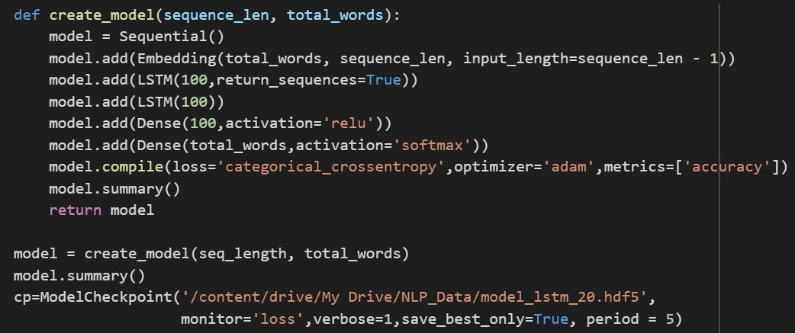
Creating LSTM Model
Now that the data is ready, We start our sequential NN by adding neural network embeddings that are useful because they can reduce the dimensionality and meaningfully represent categories in the transformed space. Generally speaking, we use an embedding layer to compress the input feature space into a smaller one.
Then we add two stacked LSTM (Long Short Term Memory) layers with 100 units each. (LSTM Algorithm will be explained in the section later.)

Slide 28
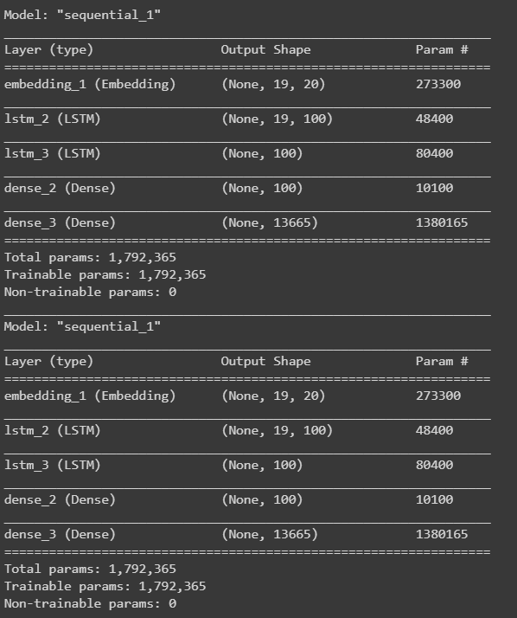
Then comes the two fully connected or dense layers first layers have 100 units or neurons and the second dense layer which is our output layer have the number of units equal to the total words. As for every input, our model will predict the probability of every word in our total_words.
We have experimented with a couple of optimizers such as RMSprop, SGD, and Adam and in our case, Adam optimizer gave us the best results. As for the loss function, we have used categorical cross-entropy.
There is no test data set, we are modelling the entire training data to learn the probability of each word in a sequence.
We are ready to train our model, we have added a callback ModelCheckpoint to save the weights after every epoch.
Then finally we fit our model with 100 epochs.

Slide 29
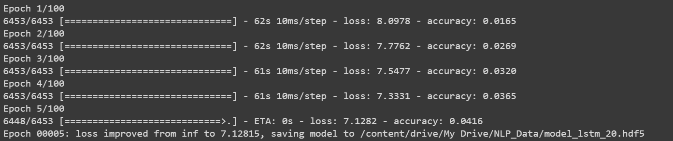
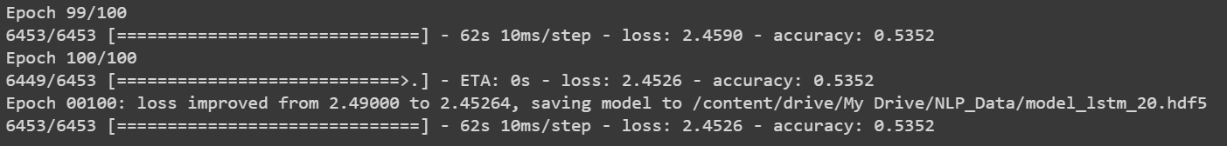
Results of training
Not “amazing”, but it should be fair enough for our test. Indeed, for a given sequence of word, there is no clear determinism in the word to be chosen. So we have to be careful not only pick-up the word with the biggest probability, but being able to choose another one with high probability too.

Slide 30
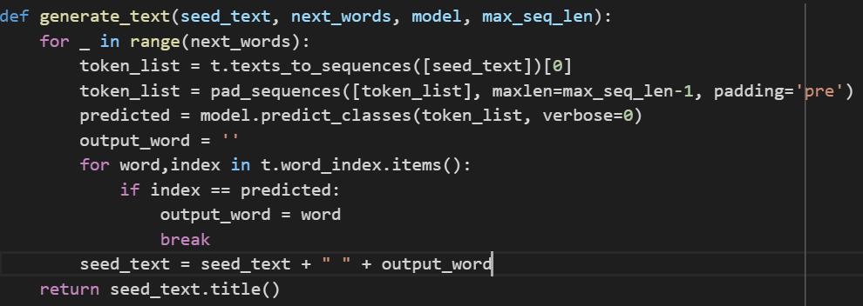
GENERATING PREDICTIONS
After training the model, we can enter the seed text and the number of words to be predicted. Since our aim is to create a model to predict the next word in a search option, we aim to generate only the next 1 or 2 words

Slide 31
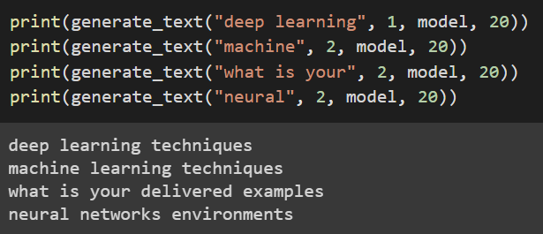
OUTPUTS
The output is generated by passing a seed text to the model along with the number of words to be predicted.

Slide 32
DEPLOYMENT
We have tried to deploy our model locally, using Flask. We have created a frontend using HTML, CSS and JavaScript, and the backend of the app is being handled using Flask. As of now the model is being deployed locally, and we are attempting to deploy it on a cloud based platform.

Slide 33
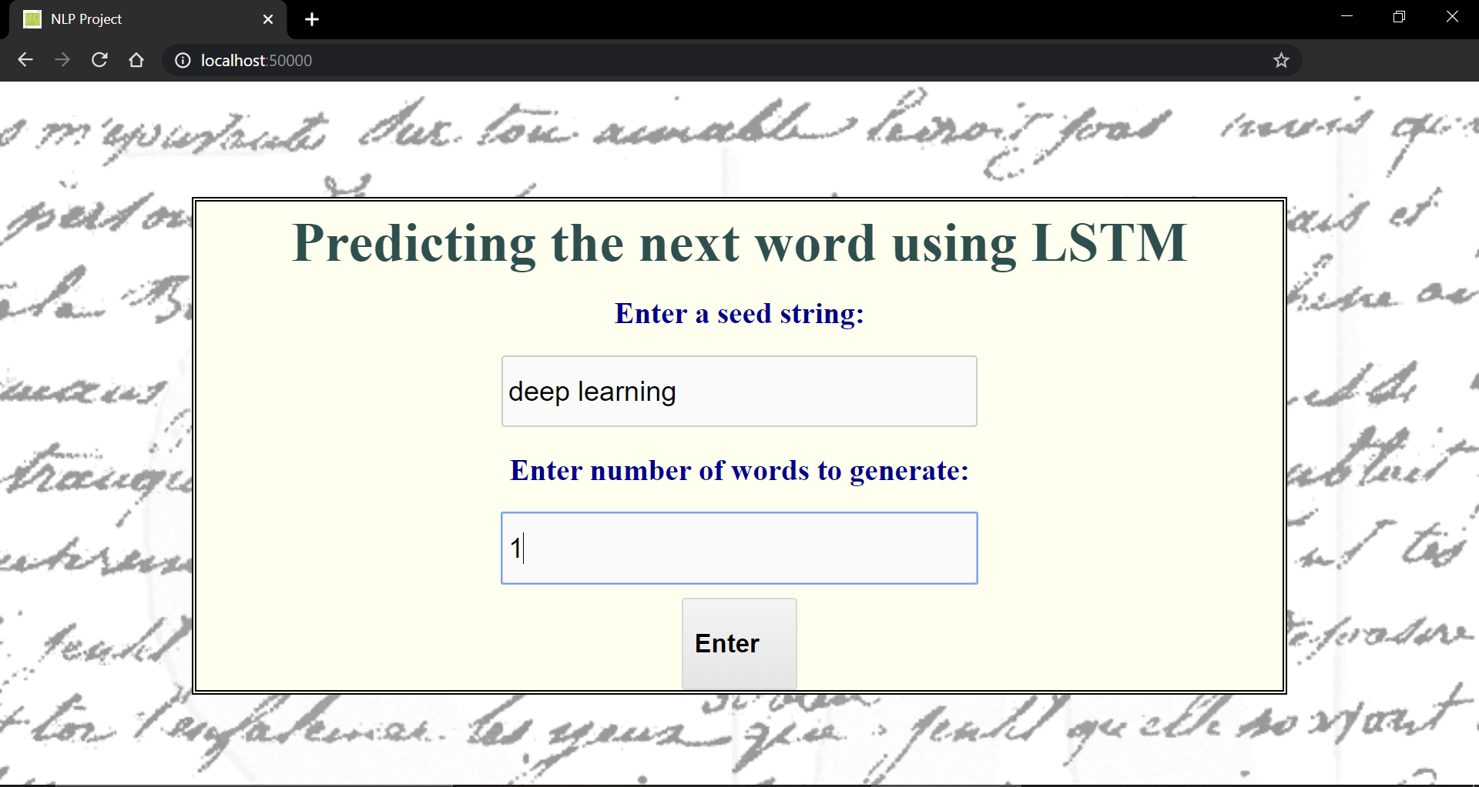
FRONT END - HOME PAGE

Slide 34
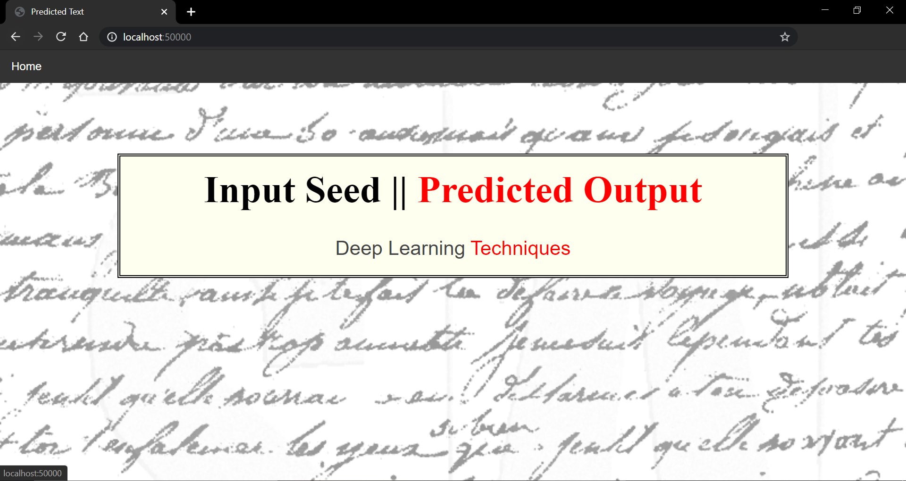
FRONT END - PREDICTED PAGE

Slide 35
CONCLUSION
We were able to successfully generate/predict the next words of a given phrase or a word.
The words generated by the model were proper English words, there were no misspelling and most of the sentences were realistic. This shows that the model has a good understanding of how letters are combined to form different words. Even though it is very obvious to do for a human, but for a computer model to give a reasonable performance at word formation is itself a huge feat.
But after few words as we keep on increasing the number of next_words generation, sentences did not mean anything, as a whole. And also the grammar was not up to the mark for more number of next_words generation.
We can probably have better results by increasing the training data, training epochs, more layers, more memory units to the layers, tuning the model to limit variance, etc. Applying these modifications could increase the capacity for the neural network to generate good phrases and less fuzzy.

